Slide 1
ReactJS
1

Slide 2
ReactJS {contents}
´ JSX
´ Virtual-DOM
´ Props
´ PropTypes
´ State
´ Refs
´ LifeCycle

Slide 3
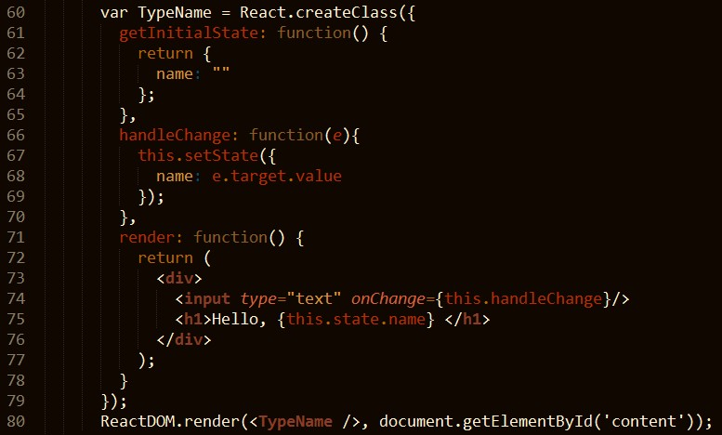
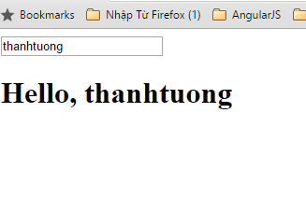
ReactJS {state}
23
 The state object is where you store property values that belongs to the component. When the state object changes, the component re-renders.
 getInitialState() function: init value for variable.
 setState() function: update new value for variable.

Slide 4
ReactJS {state-(cont)}
24
 When you should use state?
 Respond to user input.
 Server request.
 or the passage of time.

Slide 5
ReactJS { props vs state }
25
Features | props | state
Can get initial value from parent Component? | Yes | Yes
Can be changed by parent Component? | Yes | No
Can set default values inside Component? | Yes | Yes
Can change inside Component? | No | Yes
Can set initial value for child Components? | Yes | Yes
Can change in child Components? | Yes | No

Slide 6
ReactJS {refs}
27
 How we make focus to input element after clear data from input element?
 How we can make a search with many criteria ?
 …
Refs

Slide 7
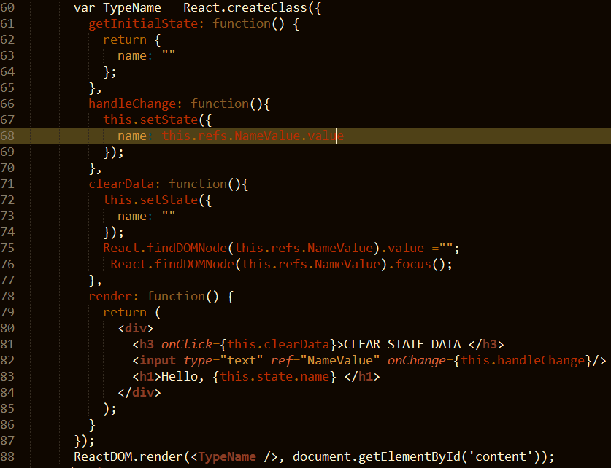
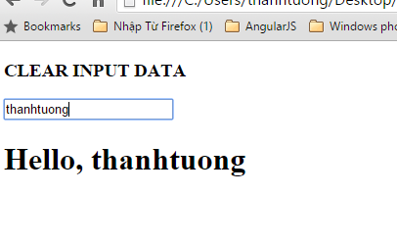
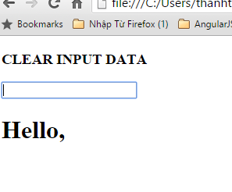
ReactJS {refs-(cont)}
28
Type…
Click clear

Slide 8
ReactJS {LifeCycle}
30
 Each component has its own lifecycle events.
 Ex:
 If we wanted to make an ajax request on the initial render and fetch some data, where would we do that?
 If we wanted to run some logic whenever our props changed, how would we do that?
 …
LifeCycle events

Slide 9
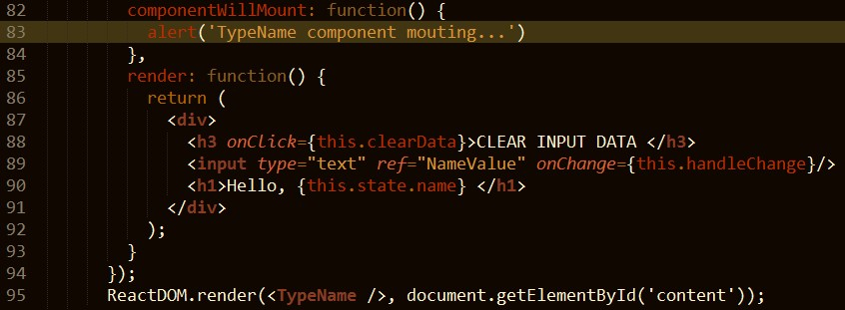
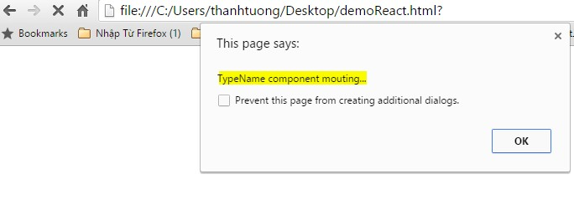
ReactJS {LifeCycle (cont)}
31
 componentWillMount
 Invoked once before the initial render.
 Good place to make connection to your db service (ex: firebase,...)
 Do not call set state method here.

Slide 10
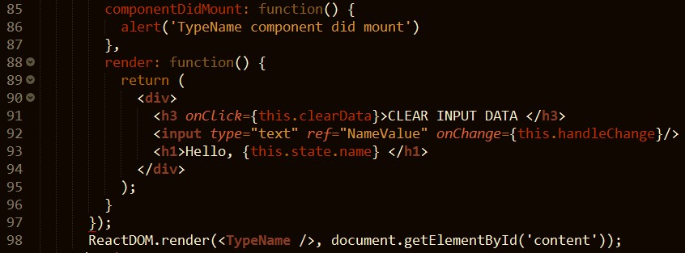
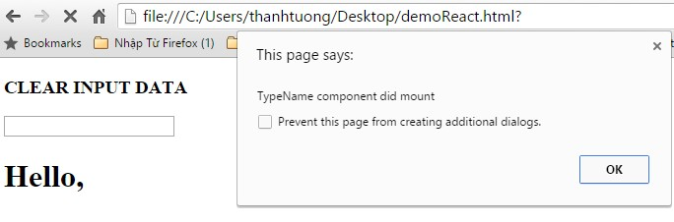
ReactJS {LifeCycle (cont)}
32
 componentDidMount
 Invoked once, only on the client
 Immediately after the initial rendering occurs.
 It is good place for you to make AJAX request to fetch data for first used.

Slide 11
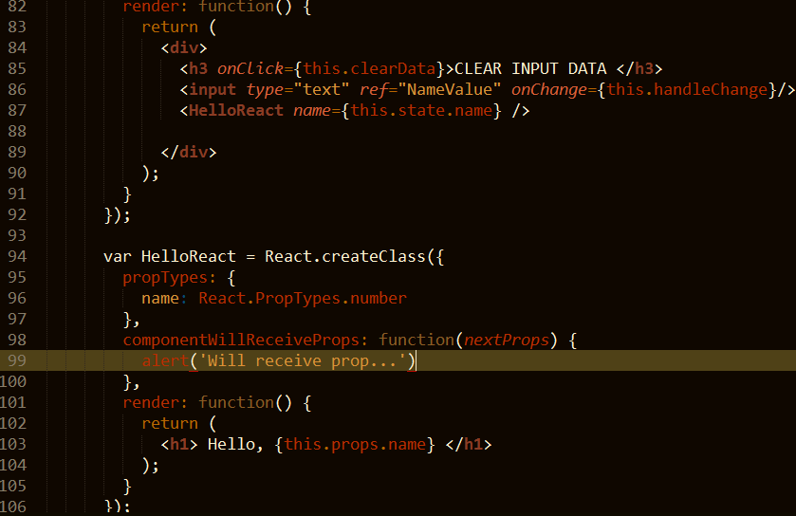
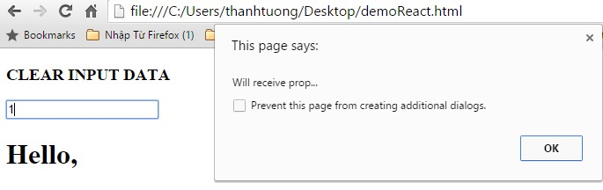
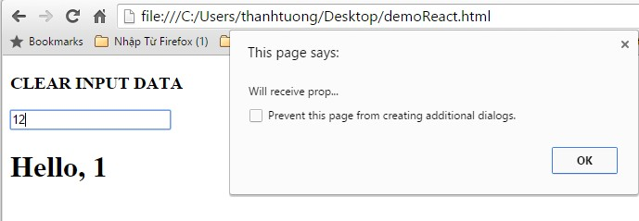
ReactJS {LifeCycle (cont)}
33
 componentWillReceiveProps
 Invoked when a component is receiving new props.
 This method is not called for the initial render.
 Use this method as a way to react to a prop change before render() is called by updating the state with setState.

Slide 12
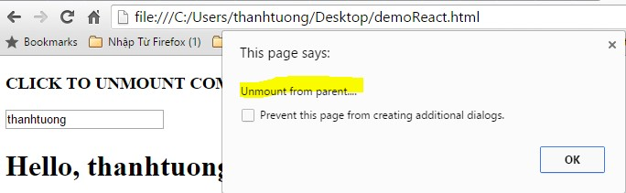
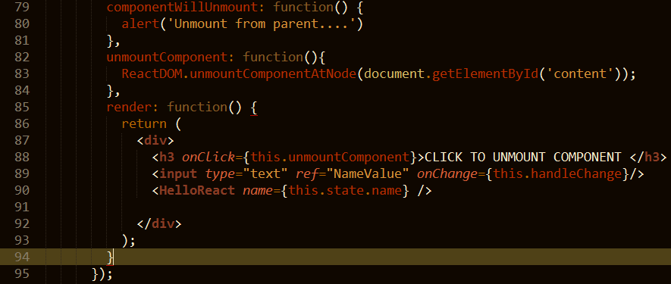
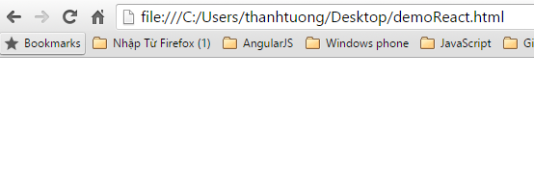
ReactJS {LifeCycle (cont)}
34
 componentWillUnmount
 Invoked immediately before a component is unmounted from the DOM.
 Perform any necessary cleanup in this method(Ex: invalidating timers, clear up DOM elements were created at componentDidMount)
http://facebook.github.io/react/docs/component-specs.html
Nothing!!!

Slide 13
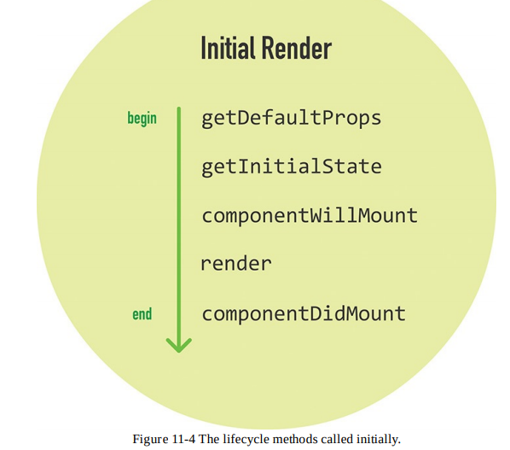
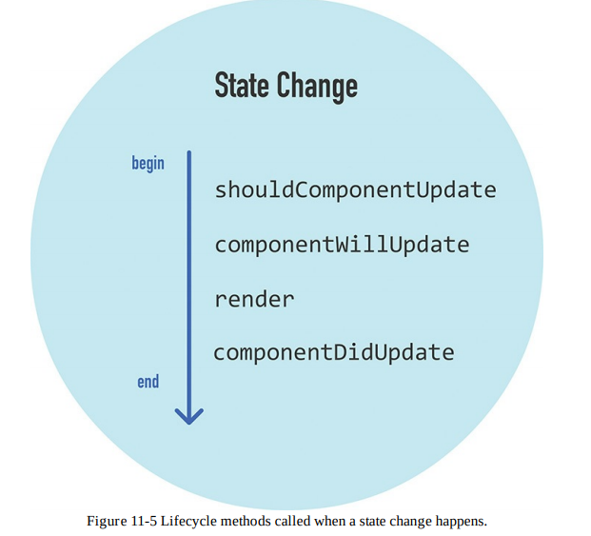
Lifecycle Methods

Slide 14
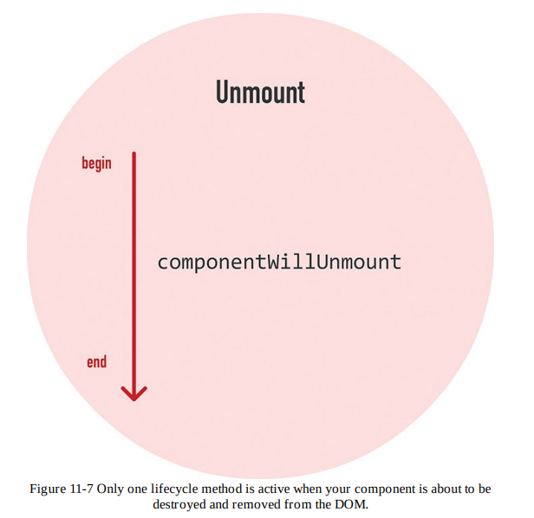
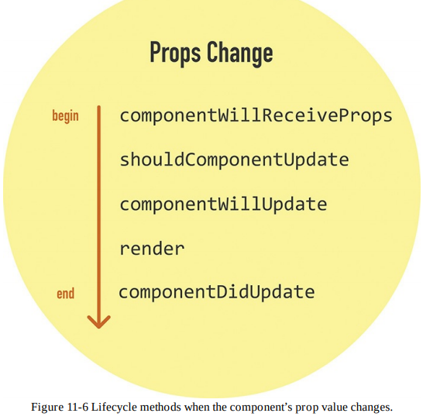
Lifecycle Methods

Slide 15
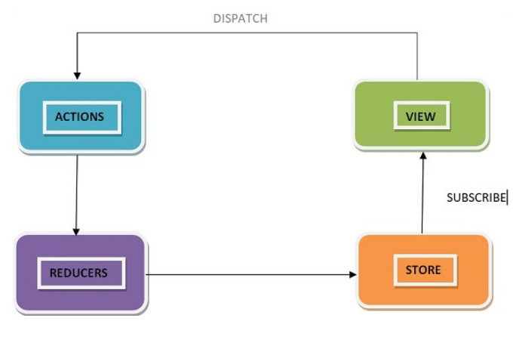
Redux

Slide 16
REACT SUMMARY
We can create our own components
We can nest components as we like
Stateless Function components are pure
We can control flow via JS(if, else, for, map ….)

